Slide 1
The Predicate Calculus(1)
하 진 영
강원대학교 컴퓨터공학과

Slide 2
The Propositional Calculus
Def: Propositional Calculus Symbols
propositional symbols : P, Q, R, S, T,...
truth symbols: true, false
connectives: ∧, ∨, ¬, →, ≡
Def: Propositional Calculus Sentences
every propositional symbol and truth symbol is a sentence
the negation(¬) of a sentence is a sentence
the conjunction(∧) or and of two sentences is a sentence
the disjunction (∨)or or of two sentences is a sentence
the implication(→) of one sentence for another is a sentence
the equivalence(≡) of two sentences is a sentence

Slide 3
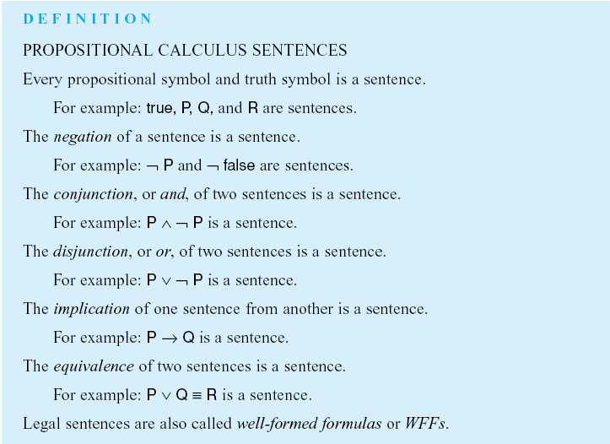

Slide 4
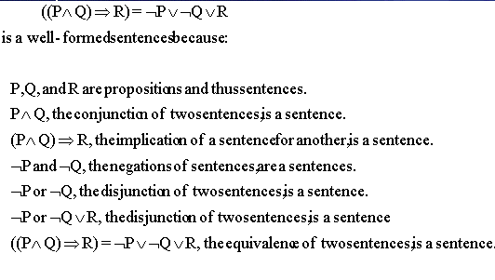
The Propositional Calculus (2)
WFFs(well-formed formulas)
legal sentences
examples

Slide 5
The Propositional Calculus (3)
Formal definition of the semantics or “meaning” of propositional sentences
a precise treatment of semantics is essential to avoid logical errors by the inference procedures
a propositional symbol corresponds to a statement about the world
e.g.
P may denote “it is raining” or Q, “I live in a brown house”
a proposition may be either true or false, given some state of the world
the truth value assignment to propositional sentences is called an interpretation

Slide 6
The Propositional Calculus (4)
Definition: Propositional Calculus Semantics
an interpretation of a set of propositions is the assignment of a truth value, either T or F, to each propositional symbol
the symbol true is always assigned T, and the symbol false is assigned F

Slide 7
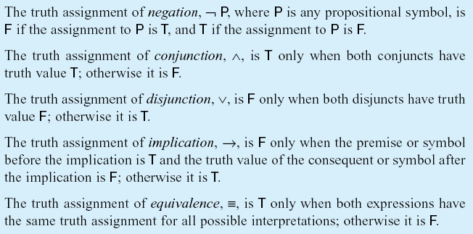
The Propositional Calculus (5)
Definition - cont.
the interpretation or truth value for sentences is determined by:

Slide 8
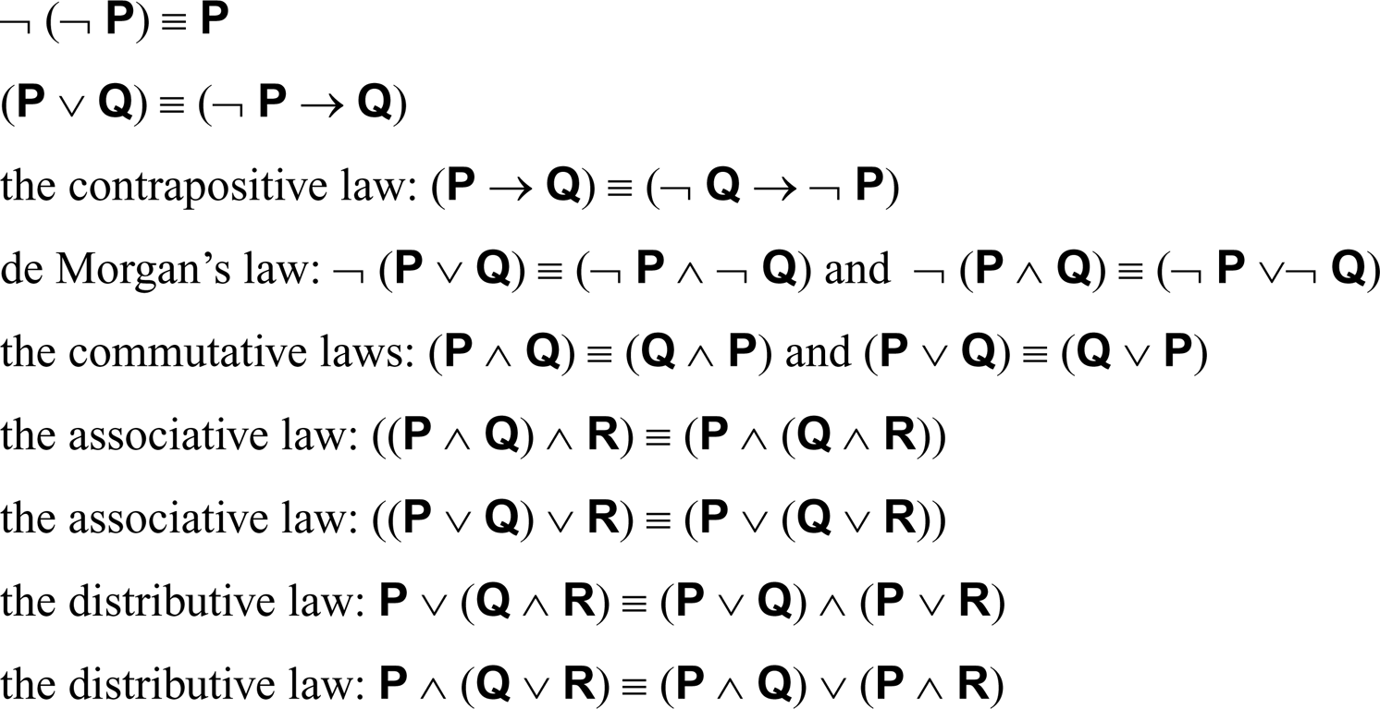
The Propositional Calculus (6)
Other important propositional relations
for propositional expressions P, Q, and R:

Slide 9
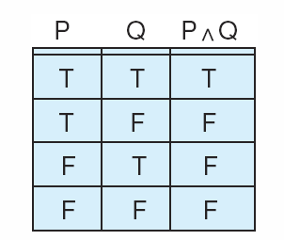
The Propositional Calculus (7)
Truth table for the operator ∧.

Slide 10
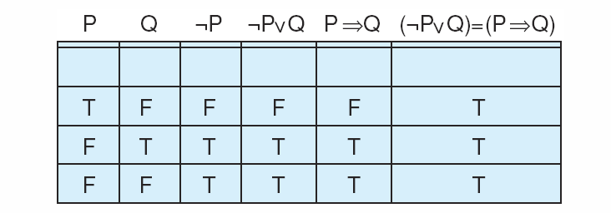
The Propositional Calculus (8)
Truth table
we can prove the propositional calculus equivalences by demonstrating that they have identical truth tables

Slide 11
The Predicate Calculus
Limitations of Propositional Calculus
no way to access the components of an individual assertion
each atomic symbol (P, Q, etc) denotes a proposition of some complexity
e.g. “it rained on Tuesday”
do not allow variables
Predicate Calculus
provides the way to access the components
e.g. weather(tuesday, rain)
through inference rules we can manipulate predicate calculus expressions, accessing their individual components and inferring new sentences
allows expression to contain variables
variables let us create general assertions about classes of entities
e.g. weather(X, rain)

Slide 12
The Predicate Calculus (2)
System of logic to express mathematics and large portions of natural language
Predicate Calculus = Propositional Calculus+ predicates + Quantification + Inference Rule
First Order Logic
Predicate Calculus + Functions
permits quantification over variables but not over predicate and functions

Slide 13
Definition
Predicate Calculus symbols
the alphabet that makes up the symbols of the predicate calculus consists of:
the set of letters, both upper- and lowercase, of the English alphabet
the set of digits, 0, 1,..., 9
the underscore, “_”
symbols in the predicate calculus begin with a letter and are followed by any sequence of these legal characters
example of legal characters include: a R 6 9 p _ z
illegal characters include: # % @ / & “ ”
legal predicate calculus symbols include:
George, fire3, tom_and_jerry, bill, XXXX
strings that are not legal predicate symbols include:
3jack, “no blanks allowed”, ab%cd, ***71, duck!!!

Slide 14
Definition (2)
Symbols and Terms
predicate calculus symbols include:
truth symbols true and false (reserved symbols)
constant symbols, which are symbol expressions having the first character lowercase: e.g. george, tree, tall, and blue
variable symbols, which are symbol expressions beginning with an uppercase character: e.g. George, BILL, and KAte
function symbols, which are symbol expressions having the first character lowercase

Slide 15
Definition (3)
Symbols and Terms (continued)
functions have an attached arity indicating the number of elements of the domain mapped onto each element of the range
e.g. father could denote a function of arity 1, and plus could be a function of arity 2
a term is either a constant, variable, or function expression
e.g. cat, times(2,3), blue, X, mother(jane), kate
a function expression consists of a function constant of arity n, followed by n terms, t1, t2,..., tn, enclosed in parentheses and separated by commas
e.g. f(X,Y), father(david), price(bananas)

Slide 16
Definition (4)
Predicates and Atomic Sentences
predicate symbols begin with a lowercase letter
e.g. likes, equals, on, near, part_of
predicates have an associated positive integer referred to as the arity of “argument number” for the predicate
predicates with the same name but different arities are considered distinct

Slide 17
Definition (5)
Predicates and Atomic Sentences (Cont’d)
an atomic sentence is a predicate constant of arity n, followed by n terms, t1, t2,...,tn, enclosed in parentheses and separated by commas
e.g. likes(george,kate). likes(X,george). likes(george,sarah,tuesday). friends(father(david),father(andrew)). helps(bill,george).
the truth values, true and false, are also atomic sentences
atomic sentences are also called atomic expressions, atoms, or propositions

Slide 18

Definition (6)
Quantifiers
followed by a variable and a sentence
universal quantifier indicates that the sentence is true for all values of its variable
existential quantifier indicates that the sentence is true for some value(s) in the domain

Slide 19
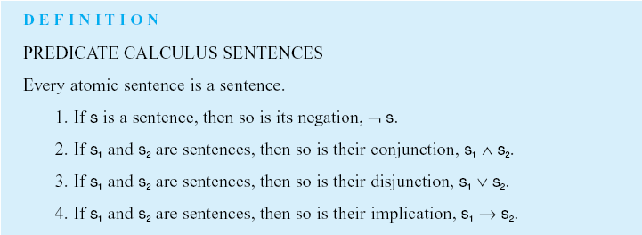
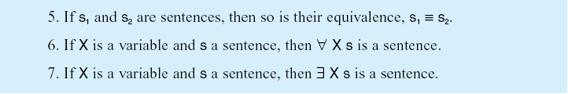
Definition (7)

Slide 20
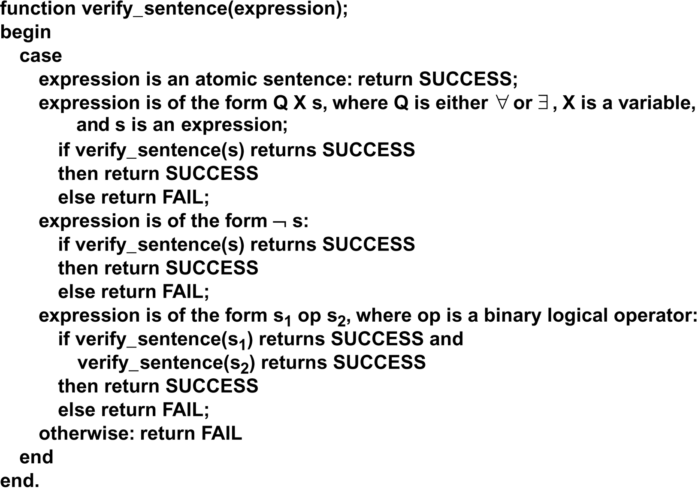
verify_sentence algorithm

Slide 21
Definition (8)
Examples of well-formed Predicate Calculus Sentences
let times and plus be function symbols of arity 2
let equal and foo be predicate symbols with arity 2 and 3, respectively
e.g.
plus(two,three) is a function and thus not an atomic sentence
equal(plus(two,three),five) is an atomic sentence
equal(plus(2,3),seven) is an atomic sentence
∃X foo(X,two,plus(two,three)) ∧ equal(plus(two,three),five) is a sentence because both conjuncts are sentences
(foo(two,two,plus(two,three))) → (equal(plus(three,two),five) ≡ true) is a sentence because all its components are sentences, appropriately connected by logical operators

Slide 22
Example
Use of predicate calculus to describe a simple world: family relationships in a biblical genealogy
mother(eve,abel).
mother(eve,cain).
father(adam,abel).
father(adam,cain).
∀X∀Y father(X,Y) ∨ mother(X,Y) → parent(X,Y).
∀X∀Y∀Z parent(X,Y) ∧ parent(X,Z) → sibling(Y,Z).
sibling(cain,abel) ???

Slide 23
Prolog source code: “family1.pl”
mother(eve, abel).
mother(eve, cain).
father(adam, cain).
father(adam, abel).
parent(X,Y) :- father(X,Y); mother(X,Y).
different(X, Y) :- X = Y, !, fail ; true.
sibling(Y,Z) :- parent(X,Y), parent(X,Z), different(Y,Z).

Slide 24
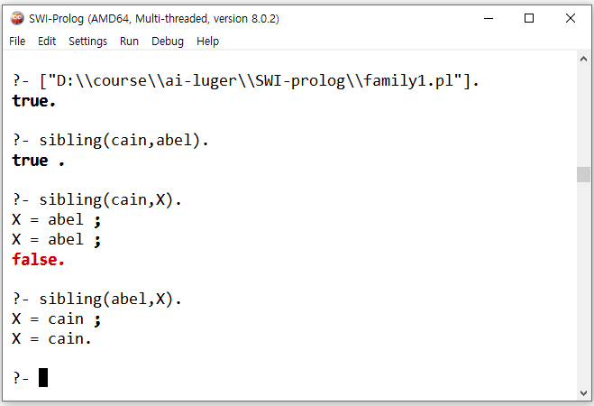
SWI-Prolog

Slide 25
Semantics for the Predicate Calculus
Meaning of a WFF : some assertion of a domain of discourse
Domain : a non-empty set (possibly infinite)
set of integers
set of all possible 8-queens configuration
Function : Mapping between domains
+ : R x R -> R
father_of : person -> person

Slide 26
Definition: Interpretation
An assignment of the entities of D to constant, variable, predicate and function symbol
constant = element of D
variable = nonempty subset of D
function f of arity m = mapping from D^{m} to D
predicate p of arity n = mapping from D^{n} to {T, F}
Given an interpretation, the meaning of an expression is a truth value assignment over the interpretation

Slide 27
Truth Value of Expressions
Interpretation
Assign T or F
to atomic
formula
Assign T or F
to compound
formula
WFFs
step1 : predicate satisfies the relation in I, then atomic formula
is T; otherwise F
step2 : assign the truth value as shown in the next slide

Slide 28
Assign T/F to Compound Sentence
Value of negation is T iff value of sentence is F
Same as propositional calculus
∀ X S is T iff S is T for all assignment to X under interpretation I
∃ X S is T if there is an assignment to X under interpretation which makes S is T

Slide 29

Examples : Predicate Representation
If it doesn’t rain tomorrow, Tom will go to the mountain.
Emma is a Doberman and a good dog.
All basket players are tall.
Some people like anchovies.
Nobody likes taxes.

Slide 30
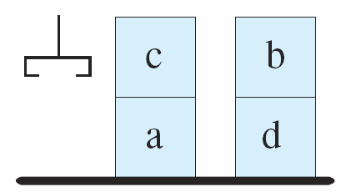
Examples : A Blocks World
A block is clear:
Stacking one block on top of another
on(c,a).
on(b,d).
ontable(a).
ontable(d).
clear(b).
clear(c).
hand_empty

Slide 31

Definition: First-Order Predicate Calculus
First-Order Predicate Calculus allows
quantified variables to refer to objects in the domain of discourse, and not to predicates or functions
predicates can occur only as predicates; nothing can be asserted about them
e.g. the following is not a well-formed expression in the first-order predicate calculus
Resolution is defined only for first-order logic

